Slide 1
Summer Internship Program
Week 1
Languages chosen:
Java C++

Slide 2
Why I chose Java and C++?
Java:
It is being taught in our current semester
It has a wide scope
I feel the need to practice and explore it more
C++ :
I’ve studied C++ in the school and I really like it
It is asked in many placement exams
I need more practice in writing codes and solving problems in it

Slide 3
Tasks done in C++
I solved 8 problems from LeetCode’s algorithm dashboard namely:
Two Sum
Reverse Integer
Palindrome Number
Roman to Integer
Longest common Prefix
Valid Paranthesis
Merge two sorted lists
Search Insert Position

Slide 4
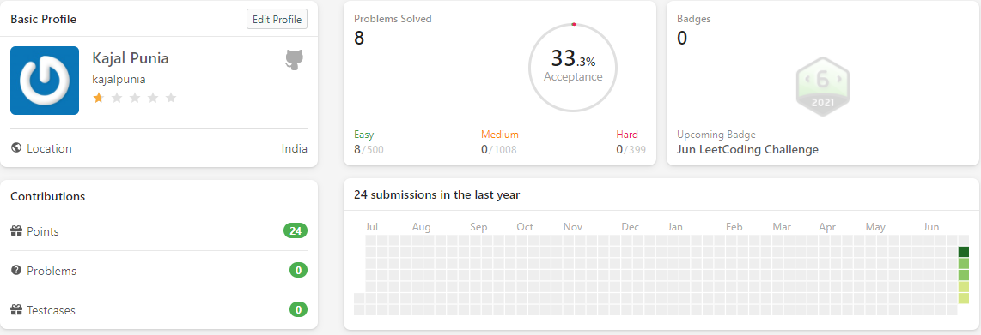
Leetcode profile

Slide 5
Tasks done in Java
I solved 4 practice problems of java from GeeksforGeeks:
Special count
Count odd even
Matrix interchange
Predict the column

Slide 6
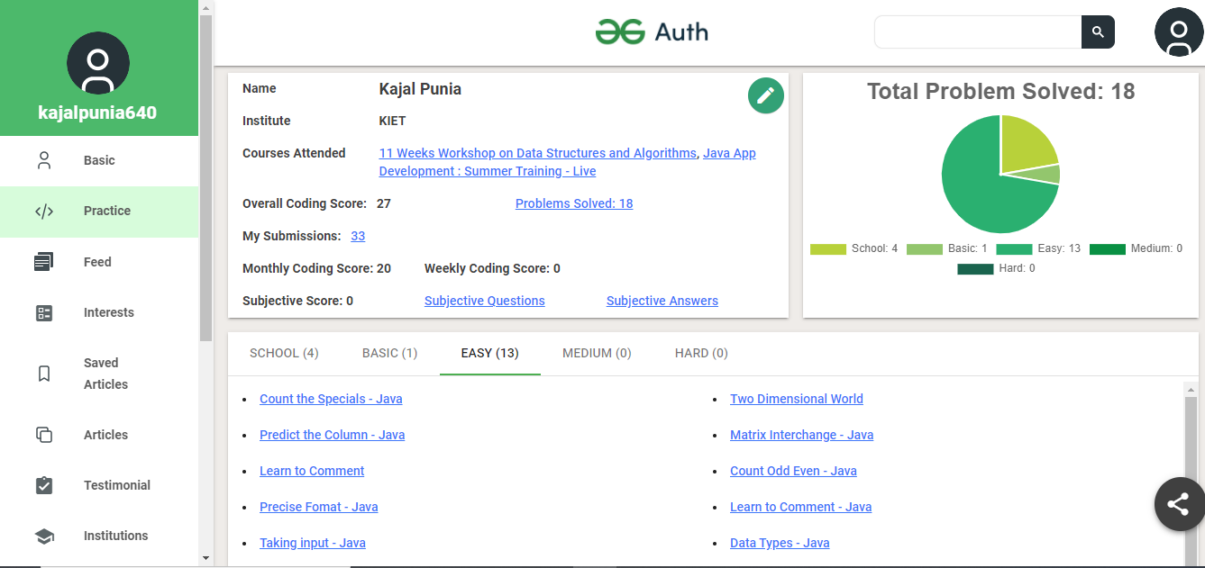
GeeksforGeeks Profile

Slide 7
Github Tasks:
Java:
I created new repository named GeeksforGeeks and uploaded 4 codes in it.
C++:
I created new repository named LeetCode and uploaded 8 codes.

Slide 8
summary
LeetCode submissions in C++ = 8; https://leetcode.com/kajalpunia/
GeeksforGeeks submissions in java= 4; https://auth.geeksforgeeks.org/user/kajalpunia640/practice/
Contributions on GitHub = 12; https://github.com/kajalpunia
Linkedin: https://www.linkedin.com/in/kajal-punia/

Slide 9
Summer Internship Program
Week 1i
Data Structures and Algorithms

Slide 10
Introduction:
A person with never say die attitude
Born and brought up is Muradnagar
Currently pursuing MCA from KIET
Completed my graduation from MMH college Ghaziabad
Schooling from Kendriya Vidyalaya Muradnagar
Strengths: Possess leadership and team work qualities, good communication skills and eager to learn new things
Weakness: Overthinking, it also helps me a bit as I analyse every situation and prepare myself for any problem that might occur in the future. But I’m also working on improving myself by meditation

Slide 11
Data Structures:
A data structure is a particular way of organizing data in a computer so that it can be used effectively.
There are generally four forms of data structures:
Linear: arrays, lists
Tree: binary, heaps, space partitioning etc.
Hash: distributed hash table, hash tree etc.
Graphs: decision, directed, acyclic etc.

Slide 12
Brief Overview of linear data structures:
An array is a finite group of data(with same data type), which is allocated contiguous memory locations, and each element within the array is accessed via an index key (typically numerical, and zero based). Array is a linear data structure.
A linked list is a linear data structure (like arrays) where each element is a separate object. Each element (that is node) of a list is comprising of two items – the data and a reference to the next node.
A stack or LIFO (last in, first out) is an abstract data type that serves as a collection of elements, with two principal operations: push, which adds an element to the collection, and pop, which removes the last element that was added. In stack both the operations of push and pop takes place at the same end that is top of the stack. It can be implemented by using both array and linked list.
A queue or FIFO (first in, first out) is an abstract data type that serves as a collection of elements, with two principal operations: enqueue, the process of adding an element to the collection.(The element is added from the rear side) and dequeue, the process of removing the first element that was added. (The element is removed from the front side). It can be implemented by using both array and linked list.

Slide 13
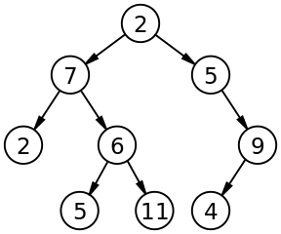
Brief Overview of Non-linear data structures:
The concept of a ‘Tree’ in its simplest terms is to represent a hierarchical tree structure, with a root value and subtrees of children (with a parent node), represented as a set of linked nodes.
A tree contains “nodes” (a node has a value associated with it) and each node is connected by a line called an “edge”. These lines represent the relationship between the nodes.
The top level node is known as the “root” and a node with no children is a “leaf”. If a node is connected to other nodes, then the preceding node is referred to as the “parent”, and nodes following it are “child” nodes.

Slide 14
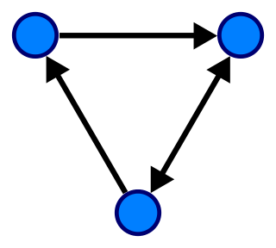
Brief Overview of Non-linear data structures:
A graph is an abstract data type intended to guide the implementation of a data structure following the principles of graph theory.
This data structure consists of:
nodes: points on the graph (also known as ‘vertices’).
edges: lines connecting each node.
The following image demonstrates a ‘directed’ graph (notice the edges have arrows indicating the direction and flow):

Slide 15
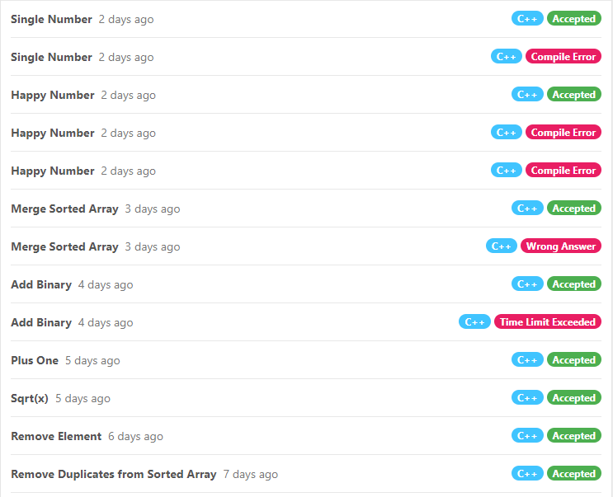
LeetCode:
Total problems
solved=8

Slide 16
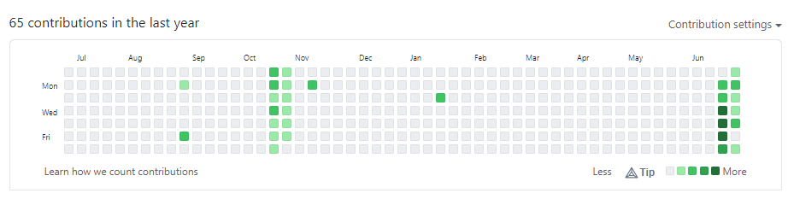
Github:
Total contributions made
in the last week= 10

Slide 17
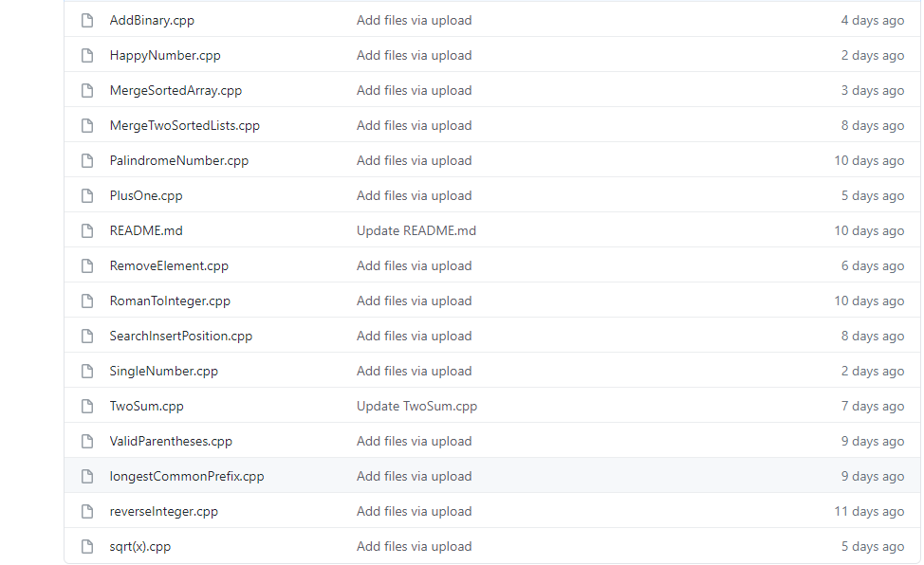

Slide 18
Summer Internship Program
Week iii
HTML CSS

Slide 19
HTML
HTML stands for Hyper Text Markup Language
HTML was created by Tim Berners-Lee in 1991.
HTML is the standard markup language for creating Web pages
It uses of various tags to format the content. These tags are enclosed within angle braces <Tag Name>. Most of the tags have their corresponding closing tags </Tag Name>.
HTML elements tell the browser how to display the content
Hypertext refers to the way in which Web pages (HTML documents) are linked together. Thus, the link available on a webpage is called Hypertext.
HTML is a Markup Language which means you use HTML to simply "mark-up" a text document with tags that tell a Web browser how to structure it to display.

Slide 20
Basic HTML Document:
<!DOCTYPE html> (Tells version of HTML)
<html> (HTML root element)
<head> (Contains page’s HTML metadata)
<title>Page title</title> (Title of the HTML page)
</head>
<body> (Holds content of the HTML page)
<h1>This is a heading</h1> (Headline tag)
<p>Paragraph content</p> (Paragraph tag)
</body>
</html>

Slide 21
<DOCTYPE! html>: This is the document type declaration (not technically a tag). It declares a document as being an HTML document. The doctype declaration is not case-sensitive.
<html>: This is called the HTML root element. All other elements are contained within it.
<head>: The head tag contains the “behind the scenes” elements for a webpage. Elements within the head aren’t visible on the front-end of a webpage. HTML elements used inside the <head> element include:
<style> <title> <base> <noscript> <script> <meta> <link>
<title>The <title> tag is used inside the <head> tag to mention the document title.
<body>: the body tag is used to enclose all the visible content of a webpage. In other words, the body content is what the browser will show on the front-end.
An HTML document can be created using any text editor. Save the text file using .html or .htm. Once saved as an HTML document, the file can be opened as a webpage in the browser.
<h1>This tag represents the heading.
<p>This tag represents a paragraph.

Slide 22
CSS
CSS stands for Cascading Style Sheets
CSS describes how HTML elements are to be displayed on screen, paper, or in other media
It can control the layout of multiple web pages all at once
There are three ways of inserting a style sheet:
1) External CSS: With an external style sheet, you can change the look of an entire
website by changing just one file! Each HTML page must include a reference to the
external style sheet file inside the <link> element, inside the head section.
2) Internal CSS: The internal style is defined inside the <style> element, inside the head
section.
3) Inline CSS: An inline style may be used to apply a unique style for a single element.
To use inline styles, add the style attribute to the relevant element.

Slide 23
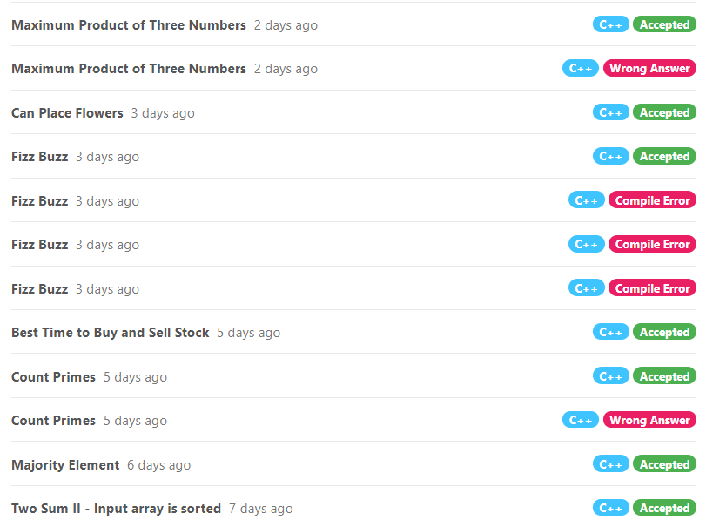
Leetcode

Slide 24
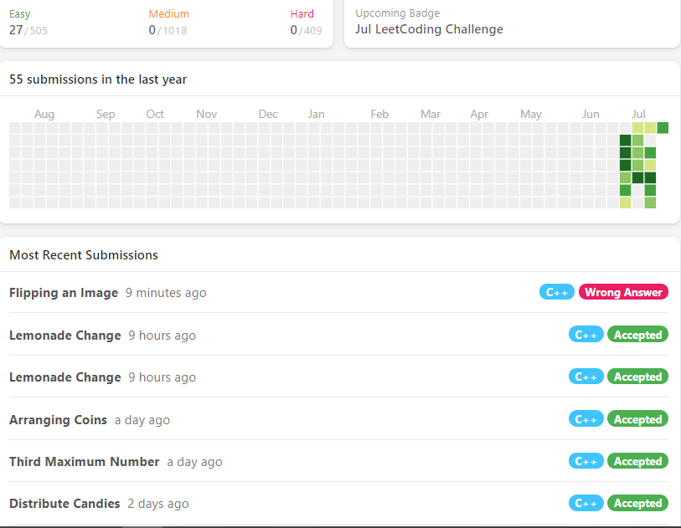

Slide 25
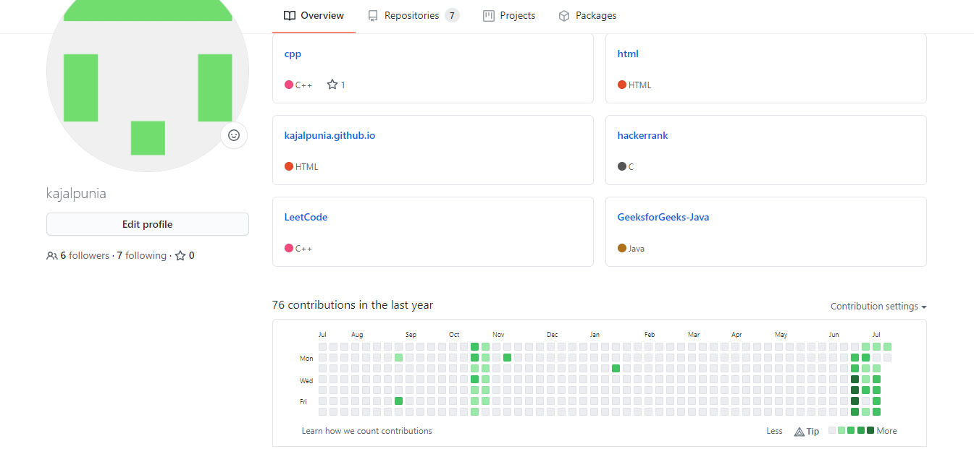
GitHub

Slide 26
Summary
Github Contributions : 11
LeetCode problems Solved : 11
CSS : Inline CSS, Internal CSS
HTML: Creating menu bar, Using bullets, Background image, Use of <aside> tag, use of sections

